Slide 1
Abiotic Factors

Slide 2
We will be going over the following:
1. | Identifying abiotic factors in ecosytems.
2. | Explaining the effect of abiotic factors.

Slide 3
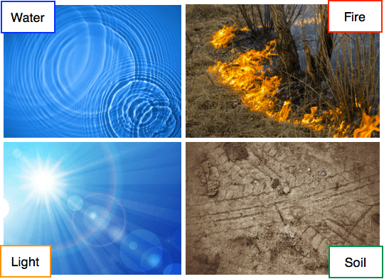
Abiotic factors are the non-living components of an ecosystem.
They affect living things, but are not themselves living.
They include things like water, temperature, fire, light, soil and gases.

Slide 4
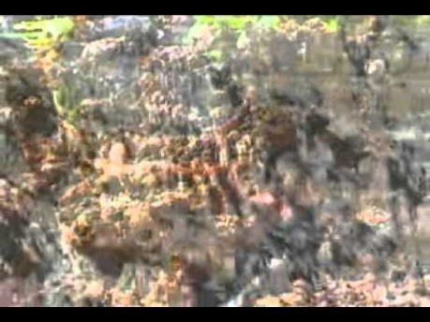

Slide 5
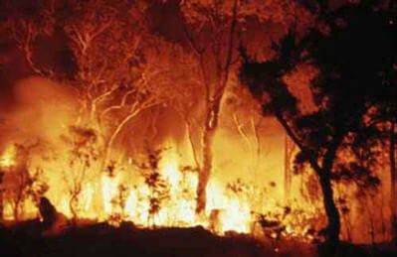
Fire is another important abiotic factor.
Fires can kill some plants, but they may also help others to grow.
When fire sweeps through an area, it releases the seeds of some plants and can help them germinate. Germination is the process of a seed growing into a new plant. Fires also make room for other plants to grow later, re-building the forest.
Indigenous Australians have used fire for thousands of years to help control the growth of plants.

Slide 6

Gas levels, are another abiotic factor.
Especially levels of oxygen, in the surrounding environment are important for processes like respiration. For organisms in aquatic environments, the colder the water, the more dissolved oxygen it contains.

